Slide 1
Logical Data Models
Record Based Models
Database Systems
Note:
Some slides and/or pictures are adapted from Lecture slides / Books of
  Peter Rob
  Jeffery. A. Hoffer
  Thomas M. Connolly
  Ramez Elmasri
  Silberschtaz

Slide 2
Logical Data Models
1) Hierarchical Data Model
2) Network Data Model
3) Relational Data Model

Slide 3
Data Models
1. Hierarchical Data Model (HDM)
The records are arranged in a top down structure that resembles a tree.
Terminologies:
  Node (also called segment) corresponds to a record
  Root Node: The top most node
  Parent & Child Nodes
  Leaf Node is a node having no children
  Siblings: The children of same parent
  Family of Nodes: All children of same node
  Hierarchical Path is a path from root node to any node
  Tree levels called segments (equivalent to records)
  Height of a tree refers to no. of levels

Slide 4
Hierarchical Data Model (HDM)
Background
It was developed in 1969 (Moon landing project).
The earliest DBMS were based on HDM.
One of the most popular HDM was IBM’s Information Management System (IMS).
For this reason, the term HDM and IMS are sometime used interchangeably.

Slide 5
Hierarchical Data Model (HDM)
Advantages
Conceptual Simplicity: The relationship between the various layers of the model is logically simple.
Data Independence
Database Integrity
Efficiency: The HDM is very efficient when a database contains a large volume of data in 1:M relationship that are fixed over time.

Slide 6
Hierarchical Data Model (HDM)
Disadvantages
Duplication: The student information is duplicated for every course .
Root Node dominates the other nodes and other nodes can’t exist independently.
Not capable to answer all sorts of queries with the same efficiency.
Supports one-to-one and one-to-many association but doesn’t support many-to-many association.
Complex
The relationships are predefined (pointer based) and new relationships cant be accommodated unless we redraw the model.

Slide 7
Data Models
2. Network Data Model (NDM)
It is an extension to HDM.
It was introduced to overcome the limited scope of the HDM.
In NDM, each node can be associated with an arbitrary number of nodes and there is no concept of root node.
Terminologies:
A relationship is called a Set.
Schema: Conceptual organization of entire database.
Subschema: View of an application
DML: Data Manipulation Language
DDL: Data Definition Language

Slide 8
Network Data Model (NDM)
Background
The Conference on Data System Language (CODASYL) formed Database Task Group (DBTG) in 1960 for the standardization of DBMS.
It released an initial report on NDM in 1971
The Integrated DBMS is the most popular example of NDM.
It is also known as CODASYL System or DBTG System.
The ANSI Standard Planning and Requirements Committee (SPARC) augmented the database standards in 1975.

Slide 9
Network Data Model (NDM)
Advantages
Conceptual Simplicity: The relationship between the various layers of the model is logically simple.
Data Independence
Database Integrity
Handles more relationship types
Data Access Flexibility: An application can access an owner record and all member records in a set.

Slide 10
Network Data Model (NDM)
Disadvantages
Complex
Inflexible
The relationships are predefined (pointer based) and new relationships cant be accommodated unless we redraw the model.
Lack of structural independence: Given its navigational data access, it remains difficult to answer all sorts of queries with the same efficiency.

Slide 11
Data Models
3. Relational Data Model (RDM)
A Relation is a mathematical concept based on the ideas of sets.
  It was first proposed by Dr. E.F. Codd of IBM Research in 1970 in a research paper "A Relational Model for Large Shared Data Banks," Communications of the ACM, June 1970.
The RDM caused a major revolution in the field of database.
The RDM is widely used database model and now the terms DBMS and RDMBS (Relational DBMS) are used interchangeably.
It represents data in form of relations.
A Relation (sometimes called a Table) is a 2-dimsnesional table of data consisting of rows & columns.
Example….

Slide 12

Data Models
3. Relational Data Model (RDM)
A Row in a relation is also called Tuple (values are written inside angular brackets <…>)
Number of tuples in a relation is called Cardinality of the relation.
Number of columns/attributes in a relation is called Degree or arity of the relation.
Each attribute has a Domain (set of valid values and format).

Slide 13
Data Models
3. Relational Data Model (RDM)
Formally, given sets D₁, D₂, …. D_{n} a relation R (relation state) is a subset of
D₁ x D₂ x … x D_{n}. Thus, a relation is a set of n-tuples
<a₁, a₂, …, a_{n}> where each a_{i} ε D_{i}
A relation consists of two parts:
  Heading consisting of fixed set of attributes or columns.
  Body or State of a relation consists of time varying set of tuples.
The schema or description of a relation is written as:
Relation_Name(Att-1,Att-2,..Att-n)
A RDM consists of 3 components:
  Data Structure: Data are organized in the form of tables or relations.
  Data Manipulation: Powerful operations using SQL.
  Data Integrity: To ensure the correctness of data.

Slide 14
Relational Data Model (RDM)
Properties of a Relation
Each relation in a database has a unique name.
Each column has a distinct name.
Each row is unique.
Entries in columns are from the same domain.
Each row/column intersection must have single or atomic value.
The order of column (left to right) is insignificant.
The order of rows (top to bottom) is insignificant.

Slide 15
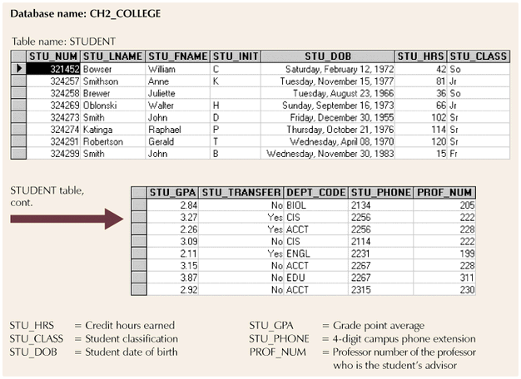
Entity set
Column (attribute)
value
Row
entity

Slide 16
Definition Summary
Informal Terms | Formal Terms
Table | Relation, Entity Set
Column or Field | Attribute
All possible Column Values | Domain
Row or Record | Tuple
Table Definition | Schema of a Relation
Populated Table | State of the Relation

Slide 17
Relational Keys
Super Key
Candidate Keys
Composite Key
Primary Key (PK)
Alternate Keys
Surrogate Key
Secondary Key, Sort Key
Foreign Key (FK)

Slide 18
Relational Keys
Determination (A -> B)
A determines B (A is called determinant)
Using the value of A, value of B can be uniquely determined OR attribute B is functionally dependent on attribute A.
STU_NUM → STU_NAME, STU_DOB, STU_CLASS
Each value in column A determines one and only one value in column B.
All of the rows in a table that agree on value for attribute A also agree in value for attribute B.

Slide 19
Relational Keys
1. Super Key
An attribute or a set of attributes that uniquely identifies a tuple within a relation.
A set of all the attributes of a relation is one of many possible super keys of a relation.
A super key may contain extra attributes that are not necessary for achieving uniqueness.
2. Candidate Key is an attribute or minimal combination of attributes that uniquely identifies each instance of an entity type.
A super key whose no proper subset is a super key.
For Ex: RollNo and RegNo of a student are candidate keys for students entity types.

Slide 20
Relational Keys
3. Composite Key:
Sometimes a single attribute is not sufficient to uniquely identify a tuple. In such situations, two or more attributes are combined together to form a key and such a key is called Composite Key.
A Composite Key must satisfy the conditions of uniqueness & Minimality i.e. Elimination of any part of key should will destroy uniqueness.

Slide 21
Relational Keys
4. Primary Key
It is an attribute or combination of attributes that is selected as an identifier for an entity type OR the candidate key that is selected for unique identification of tuples of a relation.
Primary key values are not allowed to accept NULL value
Primary key can uniquely determine the values of other attributes of the relation.

Slide 22
Relational Keys
5. Alternate Key or Keys are the keys left behind after the selection of the primary key among the possible candidate keys of an entity type.
For Ex: If RollNo and RegNo of a student are candidate keys and RegNo is chosen as the Primary Key then RollNo will be called Alternate Key.
6. Surrogate Key
Sometimes row-ids or sequential numbers are assigned to uniquely identify each tuple of the relation. Such key is called artificial key or surrogate key.
7. Secondary Key, Sort Key is a key used in data retrieval For Ex: List all students whose name is “Ali”

Slide 23
Relational Keys
8. Foreign Key (FK)
The RDM uses a set of relations liked together by a key called foreign key.
The FK is an attribute of one relation called referencing relation whose values are required to match the primary key of another relation called referenced or target relation.
Foreign keys are the glue holding the database together. Without foreign keys, the data is like leaves covering the ground in fall – you know that each leave fell from one of the trees, but it is impossible to say from which one.

Slide 24
8. Foreign Key (FK)
Consider the following two relations:
R1: EMP(EmpNo, EName,…,DeptNo)
R2: DEPT(DeptNo, DName)
The values of DeptNo in the EMP relation should either be one of the values stored in DEPT relation or it may optionally be NULL.
Relational Keys
Table Name: EMP
Table Name: DEPT
EMPNO ENAME JOB DEPTNO
7839 KING PRESIDENT 10
7698 BLAKE MANAGER 30
7782 CLARK MANAGER 10
7566 JONES MANAGER 20
DEPTNO DNAME LOC
10 ACCOUNTING NEW YORK
20 RESEARCH DALLAS
30 SALES CHICAGO
40 OPERATIONS BOSTON
Primary key
Foreign key
Primary key
Notes:
Relating Multiple Tables
Each table contains data that describes exactly one entity. For example, the EMP table contains information about employees. Categories of data are listed across the top of each table, and individual cases are listed below. Using a table format, you can readily visualize, understand, and use information.
Because data about different entities is stored in different tables, you may need to combine two or more tables to answer a particular question. For example, you may want to know the location of the department where an employee works. In this scenario, you need information from the EMP table (which contains data about employees) and the DEPT table (which contains information about departments). An RDBMS enables you to relate the data in one table to the data in another by using the foreign keys. A foreign key is a column or a set of columns that refer to a primary key in the same table or another table.
The ability to relate data in one table to data in another enables you to organize information in separate, manageable units. Employee data can be kept logically distinct from department data by storing it in a separate table.
Guidelines for Primary Keys and Foreign Keys
No duplicate values are allowed in a primary key.
Primary keys generally cannot be changed.
Foreign keys are based on data values and are purely logical, not physical, pointers.
A foreign key value must match an existing primary key value or unique key value, or else be null.

Slide 25
Integrity Constraints or Integrity Rules
To maintain the accuracy & integrity of data in the database
There are the following classes and Types of Integrity Constraints:
a) Static or Schema Constraints
  Domain Constraints
  NOT NULL Constraint
  Entity Integrity
  Referential Integrity
b) Dynamic Constraints
  Action Assertion / Business Rules / Semantic Integrity Constraints

Slide 26
Integrity Constraints or Integrity Rules
1. Domain Constraints
Domain: Set of values that may be assigned to an attribute
Attribute | Description | Domain
Empno | Set of all possible Employee Numbers (PK) | Character : size 5
Emp_Name | Set of all possible Employee Names (NOT NULL) | Character : size 25
Job | CLERK, MANAGER, SALESMAN etc. | Character : size 15
Sal | Sal is between 6000 and 40000 | Numeric : size 5
Rank | Rank can be between 1 and 5 | Numeric : size 1

Slide 27
Integrity Constraints or Integrity Rules
2. NOT NULL Constraint:
It enforces that an attribute Ai of a relation R must have some value.
    Example: if student tuple must have a valid, non-Null value for the Name attribute, then Name of STUDENT is required to be NOT NULL
3. Entity Integrity:
All PK entries are unique and No Component of the PK of a relation is allowed to have NULL values.
  Note: Some other attributes of a relation may also be constrained to disallow null values, even though they are not members of the primary key.
    Formally, t[PK] ≠ null for any tuple t in r(R)

Slide 28
Integrity Constraints or Integrity Rules
3. Referential Integrity:
It is a constraint involving two relations called referencing relation and referenced or target relation.
It specifies a relationship among tuples in two relations.
  A tuple t1 in R1 (referencing relation) is said to reference a tuple t2 in R2 (referenced relation) if t1[FK] = t2[PK].
The database must not contain any unmatched FK values.
The value in the foreign key column (or columns) FK of the referencing relation R1 can be either:
    A value of an existing primary key value of a corresponding primary key PK in the referenced relation R2, or
    a null.
In case (2), the FK in R1 should not be a part of PK of its containing relation.

Slide 29
3. Referential Integrity:
Integrity Constraints or Integrity Rules
CUSTOMER
Customer_ID
Customer_Name
Address
City
State
Zip
ORDER
Order_ID
Order_Date
Customer_ID
ORDER_LINE
Order_ID
Product_ID
Quantity
PRODUCT
Product_ID
Prduct_Desc
Product_Finish
Standard_Price
On_Hand

Slide 30
Integrity Constraints or Integrity Rules
3. Referential Integrity:
Q: What should happen if an attempt is made to delete a record from a target table, while some matching records exist in the referencing table?
There are three possible options:
Not Allowed. This is the default option.
Cascade: All the matching records in the referencing table will also be deleted.
Nullify: Null will be placed in the FK. This option is only applicable if the FK is not a part of PK.

Slide 31
Integrity Constraints or Integrity Rules
4. Action Assertion
Control on the actions of the organization
“An Employee can avail a certain facility only after a certain period of service”.
Unlike the other types of constraints, which are enforced using DDL, action assertion is enforced through some programming logic or triggers.

Slide 32
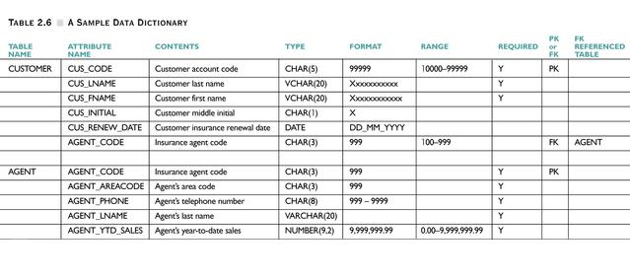
Data Dictionary
Data Dictionary (D/D) contains metadata to provide detailed information of all tables within the database.

Slide 33
Relational or Bachman Diagram
It is the graphical representation of the association or relationship between the entities or relations of a relational database.
This diagram is very helpful for conceptual understanding.
Example: -------

Slide 34
Thank you for your attention.
Reading Material
Book sections 2-5, 3-1 to 3-3, 3-5
Asif Sohail
Assistant Professor
University of the Punjab
Punjab University College of Information Technology (PUCIT)
Allama Iqbal (Old) Campus, Anarkali
Lahore, Pakistan
Tel: +92-(0)42-111-923-923 Ext. 154
E-mail: asif@pucit.edu.pk

